Slide 1

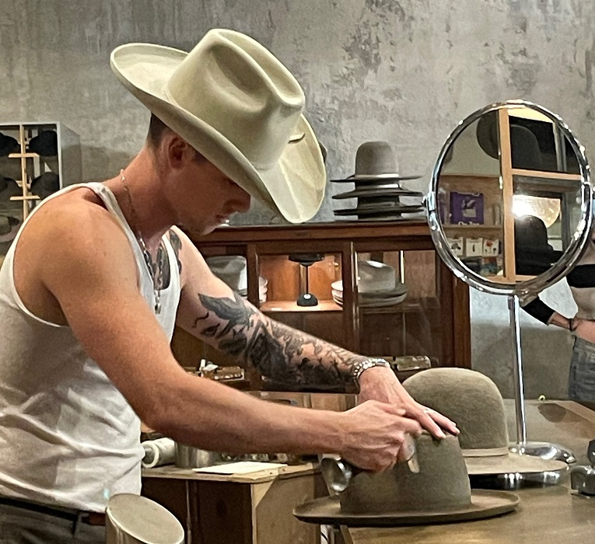
PROJECT 3
Shannon Lloyd
Isaac Gish
Vanessa Ortiz
Manasi Shidhaye

Slide 2

INTRODUCTION

Slide 3
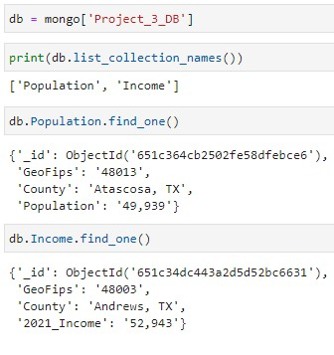
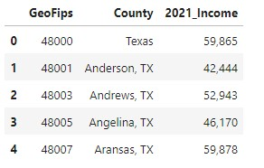
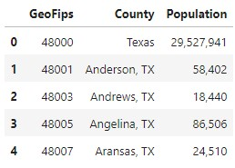
Income Population
MONGO DB

Slide 4
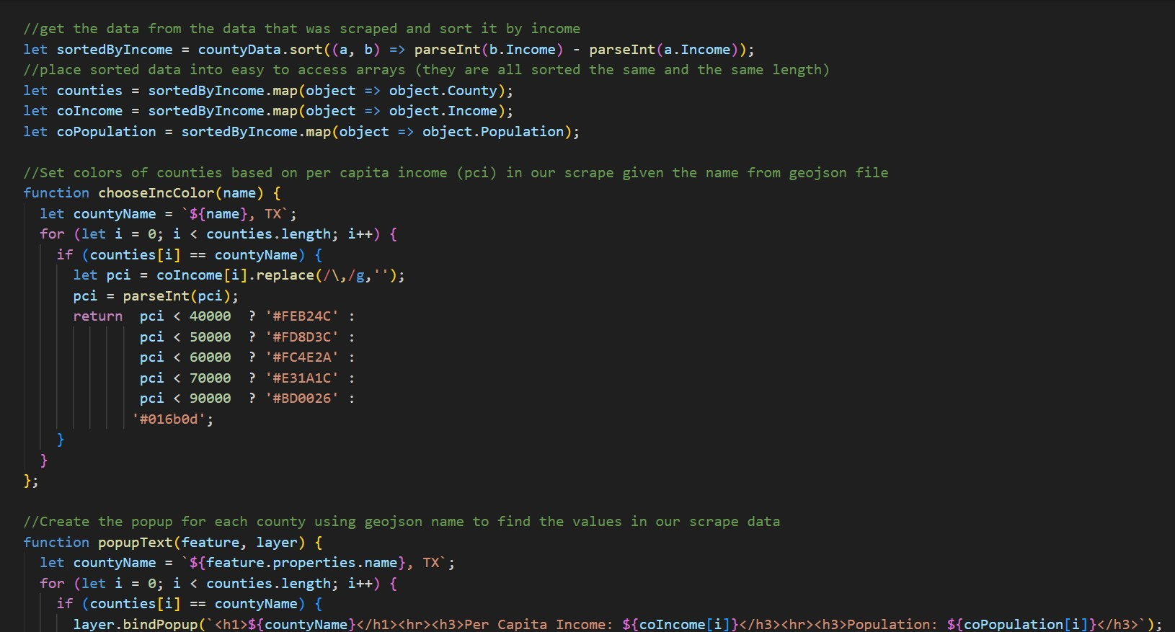
Cloropeth

Slide 5
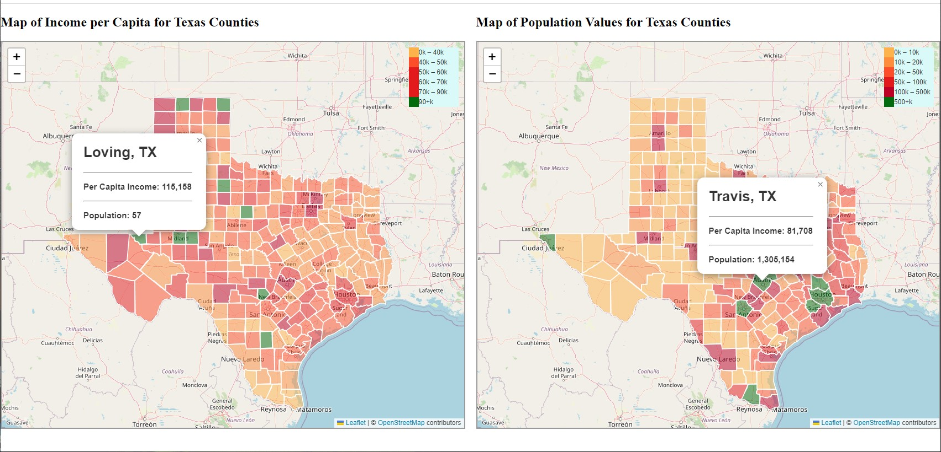
County map

Slide 6



Tools

Slide 7
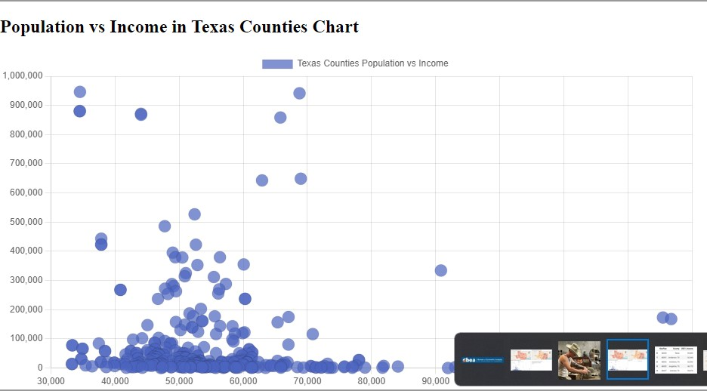
Chart.js

Slide 8
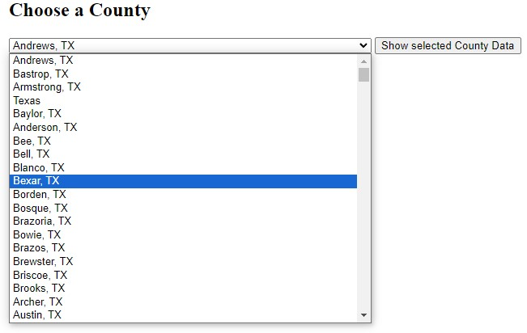
County Dropdown

Slide 9
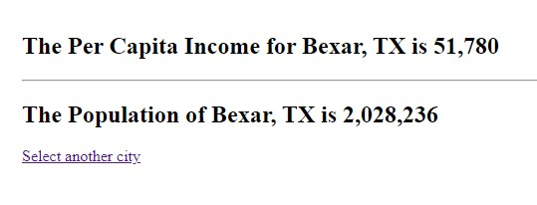
Dropdown Results

Slide 10
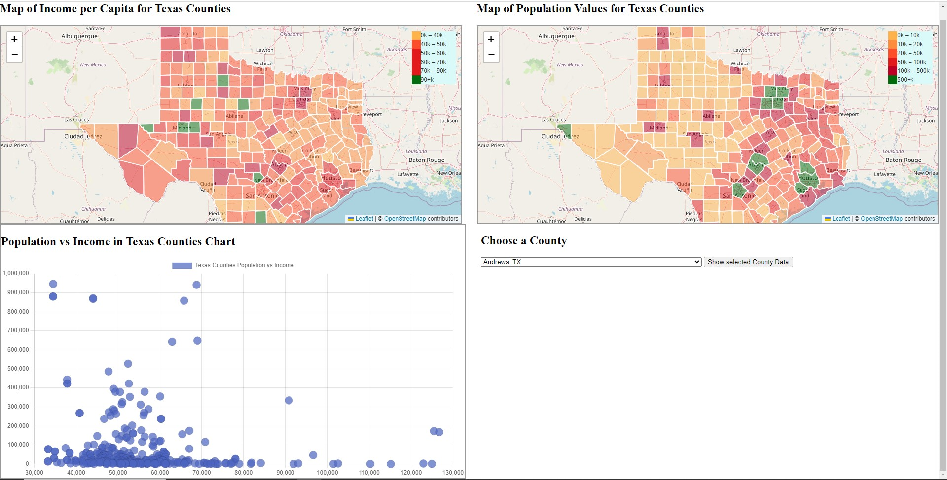
Conclusion

Slide 11
Questions

